Slide 1
Lecture 1++
Java Server Pages for
Complex Forms

Slide 2
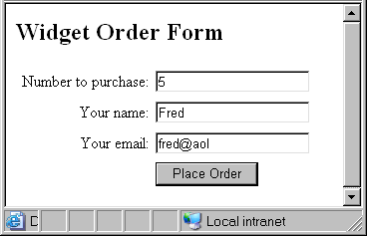
Parsing Numeric Input
getParameter method returns a String
Must parse strings into numbers before performing numeric computations
This is “5”, not the number 5!

Slide 3
Parsing Numeric Input
Useful built-in methods:
Parsing a whole number string (such as “57”):
int Integer.parseInt(String)
Parsing a decimal string (such as “5.7”)
double Double.parseDouble(String)
Example:
String quantity = request.getParameter(“quantity”);
int quantityNumber = Integer.parseInt(quantity);

Slide 4
Numeric Input Example
<%
String name = request.getParameter("customerName");
String email = request.getParameter("customerEmail");
String quantity = request.getParameter("quantity");
double pricePerUnit = 9.95;
int quantityNumber = Integer.parseInt(quantity);
double totalCost = pricePerUnit * quantityNumber;
%>
<h2>Order Confirmation</h2>
<p>Thank you for your order of <%= quantity %> widgets, <%= name %>.</p>
<p>At $<%= pricePerUnit %>, your bill will be $<%= totalCost %>.</p>
<p>You will shortly recieve an email confirmation at <%= email %>.</p>

Slide 5
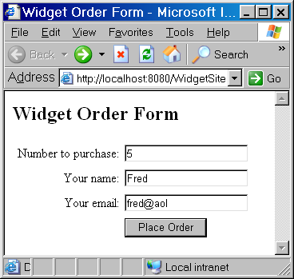
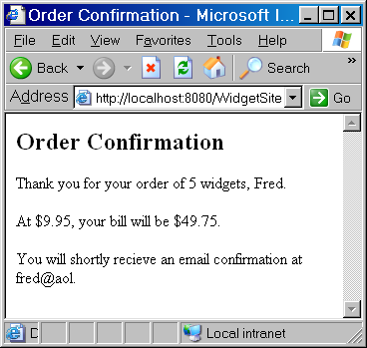
Numeric Input Example

Slide 6
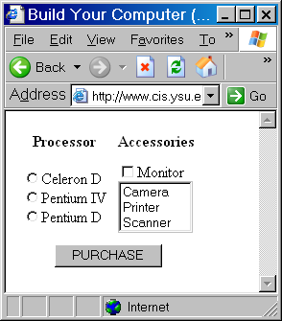
Complex Input Elements
Checkboxes
Radio Buttons
Lists
Require more
complex handling
  Will do truly complex
  handling in multipage
  servlet structures

Slide 7
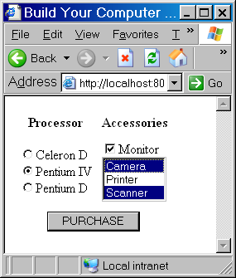
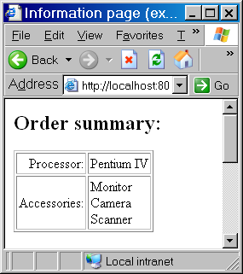
Example Result

Slide 8
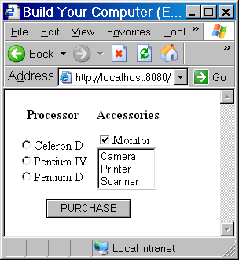
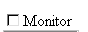
Checkbox HTML
Basic form:
<INPUT TYPE="checkbox“ NAME="monitor">
Monitor
String passed to server:
  “ …monitor=on… ” if monitor is checked
  No mention of monitor if not checked

Slide 9
Checkbox JSP
If execute JSP code:
String monitor =
request.getParameter("monitor");
monitor will have the value
  “on” if the checkbox was checked
  null if the checkbox not checked
    null is always returned if ask for value of parameter which was not passed in the request string

Slide 10
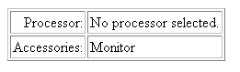
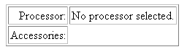
Conditions in Java
JSP may need to do different things depending on checkbox
  Display “Monitor” if checked
  Display nothing if not checked
This requires a Java condition
  Basic syntax like C++/JavaScript
  if(condition) {
  statements to execute if true
  }
  else {
  statements to execute if false
  }

Slide 11
Conditional HTML Display
Key: Display different html based on condition
Put html in conditional statement
  Must use <% and %> to differentiate Java, html
  <%
  if (condition) {
  %>
  html to display if condition true
  <%
  }
  else {
  %>
  html to display if condition false
  <%
  }
  %>

Slide 12
Checkbox Example
<%
if (monitor != null) {
%>
Monitor<br>
<%
}
%>
If this Java condition is true (the monitor is not null)
Display this html

Slide 13
Radio Button HTML
Convention: Only one in group checked
Must give all in group same name
Must give each different VALUE
<INPUT TYPE="radio"
NAME="processor" VALUE="Celeron D">
Celeron D<BR>
<INPUT TYPE="radio"
NAME="processor" VALUE="Pentium IV">
Pentium IV<BR>
<INPUT TYPE="radio"
NAME="processor" VALUE="Pentium D">
Pentium D

Slide 14
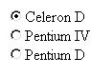


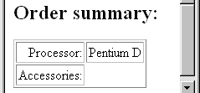
Radio Button JSP
Sent in form …name= value… to server
  processor=Celeron+D
  processor=Pentium+IV
  processor=Pentium+D
Can access value using:
String processor =
request.getParameter("processor");
And display in html:
<%= processor %>

Slide 15
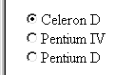
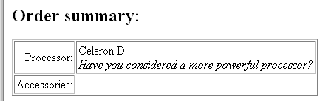
String Comparison
May need to base html on value passed:
Must use .equals method to compare strings
Basic form:
if (string1.equals(string2) { …
Example:
<% if (processor.equals(“Celeron D”) { %>
<br/><i>Have you considered a more powerful processor?</i>
<% } %>

Slide 16
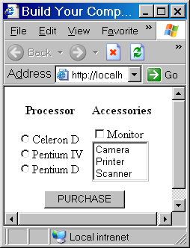
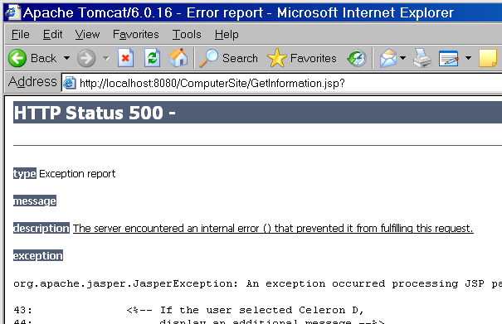
Null Input
User may not choose any radio button!
  processor will have value null
  Executing .equals on null will give run time exception
    User should never see this!

Slide 17
Detecting Null Input
Basic form of code:
if (variable != null) {
if (variable.equals(value1)) {…}
if (variable.equals(value2)) {…}
}
else {
code for case where no button selected
}

Slide 18
Detecting Null Input
Example:
<% if (processor != null) { %>
<%= processor %>
<% if (processor.equals("Celeron D")) { %>
<br/><i>Have you considered a more
powerful processor?</i>
<% } %>
<% }
else {
%>
No processor selected.
<%
}
%>

Slide 19
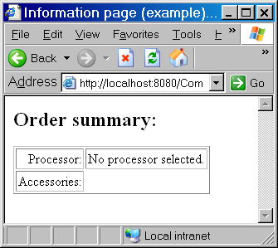
Detecting Null Input
Note: At this level of complexity, may handle with separate redirection servlet

Slide 20
List HTML
Basic form:
<SELECT NAME=“listname” SIZE=“numvisible”>
<OPTION VALUE=“value1”/> label1
<OPTION VALUE=“value2”/> label2
…
</SELECT>
Example:
<SELECT NAME="peripherals" SIZE="3">
<OPTION VALUE="Camera“/>Camera
<OPTION VALUE="Printer“/>Printer
<OPTION VALUE="Scanner“/>Scanner
</SELECT>

Slide 21
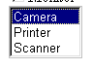
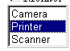
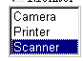
List JSP
Sent in form …name= value… to server
  peripherals=Camera
  peripherals=Printer
  peripherals=Scanner
Can access value using:
String peripherals =
request.getParameter("peripherals");

Slide 22
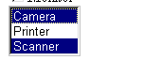
Multiple Selection Lists
Can allow user to select multiple options from list
with MULTIPLE attribute
<SELECT NAME="peripherals" SIZE="3“
MULTIPLE>
Sends name=value string for each option selected
…peripherals=camera&peripherals=scanner…
getParameter method will not work!

Slide 23
JSP for Multiple Selection Lists
String[] request.getParameterValues(String name)
Example:
String [] peripherals =
request.getParameterValues("peripherals");
creates the array:
Returns array of values passed for this name
peripherals
0 | “Camera”
1 | “Scanner”

Slide 24
Looping Through Arrays
Often use loop to process all values selected
Basic form in Java:
for (int i = 0; i < arrayname.length; i++) {
code to process i^{th} element of arrayname
}
Can use to display html multiple times
<% for (int i = 0; i < arrayname.length; index++) { %>
html created from i^{th} element of arrayname
<% } %>
Note: Java has built-in length property for array which evaluates to its size

Slide 25
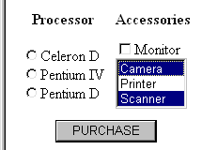
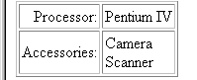
Looping Through Arrays in JSP
Example:
<% for (int i = 0; i < peripherals.length; i++) { %>
<%= peripherals[i] %><br\>
<% } %>
For each value in the peripherals array
Display that value in html
peripherals[0]
peripherals[1]

Slide 26
Checking for NULL Lists
User may not choose any value in a list
request.parameterValues will return null instead of an array
Must check for this before processing array
if (arrayname != null) {
for (int i = 0; i < arrayname.length; i++) {…}
}
else {
code to handle case where no option selected
}

Slide 27
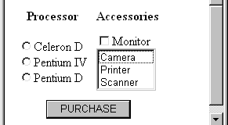
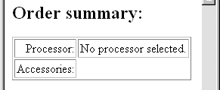
Checking for NULL Lists
Example:
<% if (peripherals != null) { %>
  <% for (int i = 0; i < peripherals.length; i++) { %>
  <%= peripherals[i] %><br>
  <% } %>
<% } %>
Only executed if peripherals exist

